Slide 1
Building Cloud Native Apps in ASP.NET
Dustin Ewers | Consultant @ Centare
www.dustinewers.com
https://www.linkedin.com/in/dustinewers/
Github: https://github.com/DustinEwers/cloud-native-dot-net

Slide 2
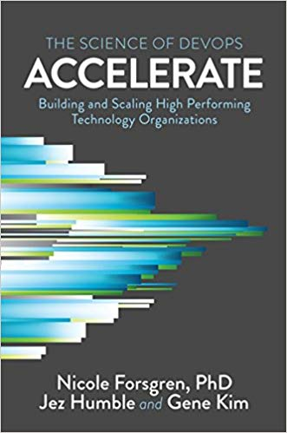
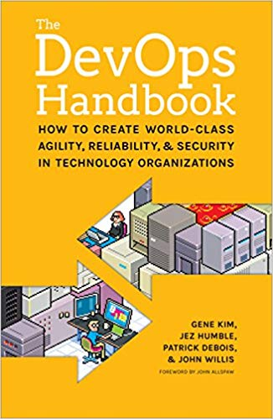
Background
Notes:
Developer -> DevOps -> Cloud -> Cloud Native
The big lightbulb moment for me was reading Accelerate (and the Dev Ops Handbook) and realizing what good practices can do for both organizations and individual developers.
The big win for me is using cloud technologies and dev ops to enable a more sane workflow for developers.
Abolishing the idea of throwing crap over a wall for someone else to deal with.
It’s a continuation of Agile. More focused on results than filling out paperwork.
----
I’m at the front end of upgrading an app to be cloud native.
I’m also going to focus more on app design

Slide 3
“Cloud native technologies empower organizations to build and run scalable applications in modern, dynamic environments such as public, private, and hybrid clouds. Containers, service meshes, microservices, immutable infrastructure, and declarative APIs exemplify this approach.
These techniques enable loosely coupled systems that are resilient, manageable, and observable. Combined with robust automation, they allow engineers to make high-impact changes frequently and predictably with minimal toil.
The Cloud Native Computing Foundation seeks to drive adoption of this paradigm by fostering and sustaining an ecosystem of open source, vendor-neutral projects. We democratize state-of-the-art patterns to make these innovations accessible for everyone.“
-- Cloud Native Computing Foundation
Notes:
One of those terms that seems obvious, but has a more specific definition.
Practically speaking:
Microservices on containers, usually paired with Kubernetes

Slide 4
Practically Speaking…
Stateless Apps
Containers
Orchestration
Notes:
Stateless Apps – usually microservices, 12 factor framework
Containers – usually docker
Orchestration – usually Kubernetes

Slide 5
Cloud Native Benefits
Power
Portability
Cost
Replicability
Human Happiness
Notes:
What’s in it for me?
Power – Building cloud native is powerful. You can put your stuff anywhere and you have the power of a full datacenter at your command with some scripts
Portability – You can move from one cloud to another with ease
Cost – Building on top of Docker and Kubernetes allows you to utilize your resources more efficiently than using VMs
Replicability – Code as Infrastructure is really important
Human Happiness

Slide 6

Roadmap
Design
Build
Deploy
Advocate
Notes:
Photo by Andrew Neel on Unsplash

Slide 7
Design Principles
How to Build Cloud Native Apps

Slide 8

12 Factor Apps
Notes:
An App framework to sell more Heroku

Slide 9
12 Factors
Codebase
Dependencies
Config
Backing Services
Build, Release, Run
Processes
Port Binding
Concurrency
Dev/Prod Parity
Logs
Admin Processes
Resources
https://12factor.net/
http://www.clearlytech.com/2014/01/04/12-factor-apps-plain-english/

Slide 10
Abstract Infrastructure Dependencies
Databases
File Systems
Data Caches
External Services
Notes:
Abstract them

Slide 11
Application Configuration
Notes:
Keep it outside of your app
Easy to do in .NET Core
KeyVault
Environment Variables
Also, make sure your external services are configurable urls

Slide 12
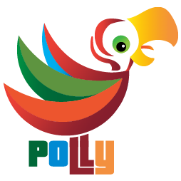
Resiliency
http://www.thepollyproject.org/
Notes:
The cloud achieves resiliency through redundancy.
Your calls are going to fail. Make sure your application can support failure.
Use a resiliency library like Polly to implement resiliency patterns.
https://docs.microsoft.com/en-us/azure/architecture/guide/design-principles/self-healing

Slide 13
Stateless Applications
Notes:
The ultimate goal is to build stateless applications that can run in parallel.

Slide 14
Data Caching
Avoid Memory Cache
Use Distributed Cache

Slide 15
Design for Evolution
Build for Testability
Isolate Domain Code
Build APIs
Notes:
Your app will change and evolve. Design for that to happen.
https://docs.microsoft.com/en-us/azure/architecture/guide/design-principles/design-for-evolution

Slide 16
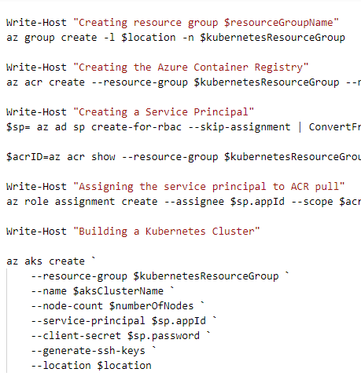
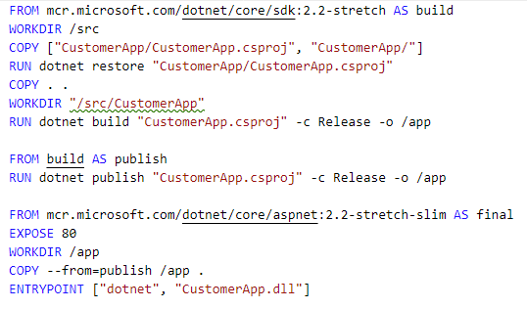
Infrastructure as Code

Slide 17
Building Cloud Native Apps
Notes:
Assume you already have an application with the previous design principles. Let’s get that application ready to be deployed.

Slide 18
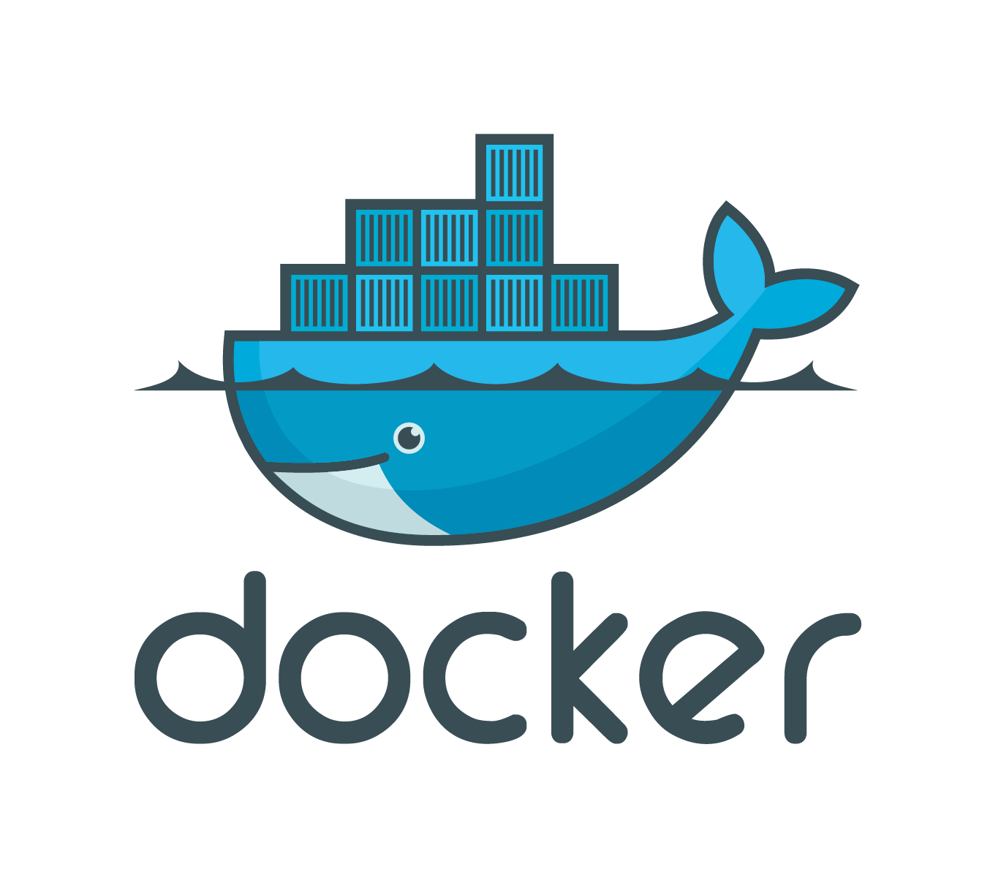

Slide 19
VMs vs. Containers
Virtual Machines
Containers
Application
Application
Bins/Libraries
Bins/Libraries
Application
Application
Guest OS
Guest OS
Bins/Libraries
Bins/Libraries
Hypervisor
Container Engine
Host OS
Host OS
Server
Server
Notes:
Containers don’t have a full OS for each container, which saves space
30% more servers on containers

Slide 20
Layered Containers
Container Image
Application Artifacts (your app)
Common Hardening / Configuration
Reusable
Application Platform (ex - .NET Core)
Base Image (ex - Alpine Linux)

Slide 21
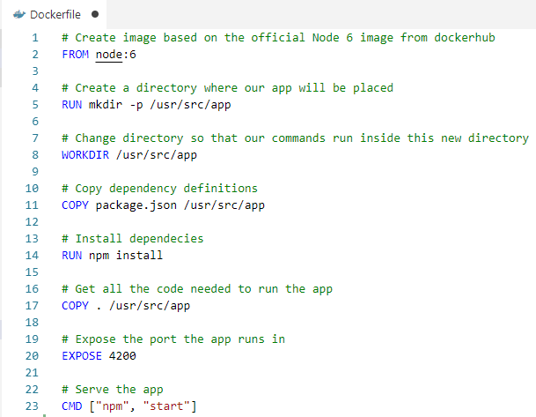

Slide 22
Using Docker With ASP.NET

Slide 23
Windows Containers vs Linux Containers
Notes:
AKS doesn’t support Windows Nodes, but Kubernetes does as of 1.4
Use .NET Core if you can.
.NET Core is Bueno
.NET Full is less so

Slide 24
Demo
Notes:
Docker file in .NET
Creating projects with Docker Support
Docker Extensions for Visual Studio Code
You don’t have to have docker installed on your machine
Docker Context

Slide 25
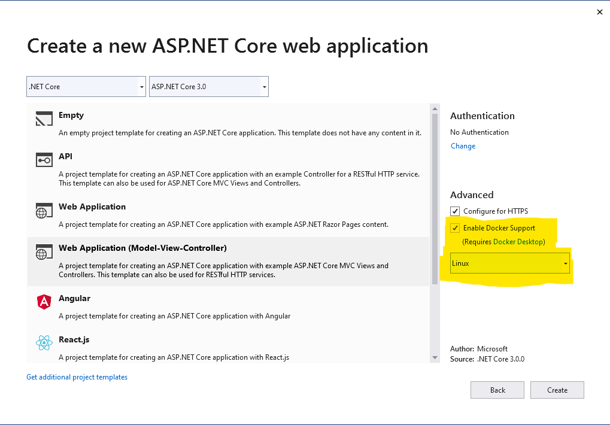
Visual Studio Support
Notes:
Visual Studio Support
- It will even prompt you to install Docker Desktop to debug the app locally
Supports Docker and you can Out of the Box debug,
You can also add Docker after the fact, but I’ve never gotten that part to work.
Shell out and do a File -> New with Docker Support
Syntax highlighting exists for VS Code as well

Slide 26
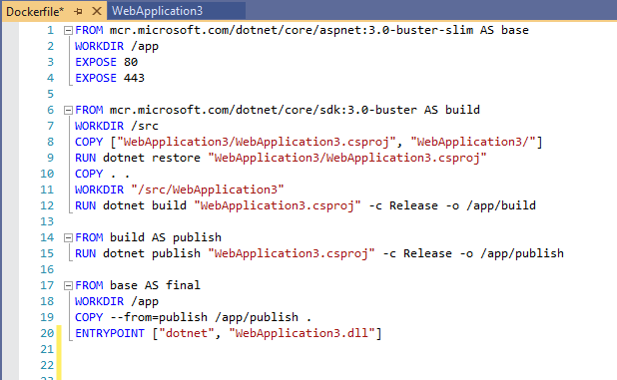
Notes:
This is the default MS Docker File
One odd thing is that it puts the file in the root path, but runs it like it’s in the base app,
So you need to set your docker context manually

Slide 27
Building Cloud Native Infrastructure in Azure

Slide 28
Infrastructure Checklist
Place to store your containers (Container Registry)
Place to run your containers (A Container Orchestrator)
Data Store (Databases, cache, file storage, etc…)
Strong Beverage

Slide 29


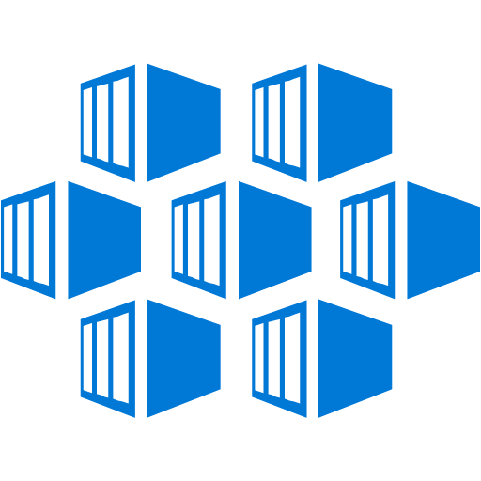
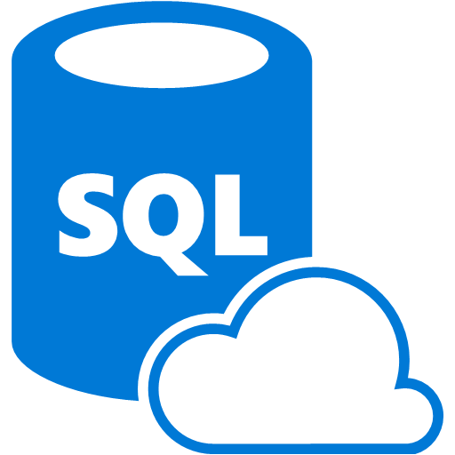

Ecosystem
Container Registry
Key Vault
SQL Database
Kubernetes Services
Managed Cluster
Storage Accounts
Notes:
Container Image
Container Hosting
External Services

Slide 30
Azure Container Registry
Supports Docker, DC/OS, Mesosphere, Helm
Basic, Standard, and Premium Tiers
Includes Build Tasks
Cheap - $0.167 - $1.667 / day
RBAC for Access
Notes:
Supports Docker, DC/OS, Mesosphere
- Lots of different container registries
Basic, Standard, and Premium Tiers
Price and Storage are the main differentiators
Premium support geo replication
Can Geo Replicate across regions
It’s cheap… why the hell are you doing your own

Slide 31
Azure Kubernetes Service
Managed Kubernetes Cluster
Only Pay for the VMs
Integrates with RBAC and Active Directory
Can’t scale up, can scale out

Slide 32
Azure Cloud Native Services
Service | Purpose
Azure Container Registry | Build and Store app images
Azure Kubernetes Service | Run applications
Azure SQL | Store application data

Slide 33
Demo
Notes:
Show the infrastructure generation scripts to build an Azure Environment

Slide 34
Deploy Your Application

Slide 35
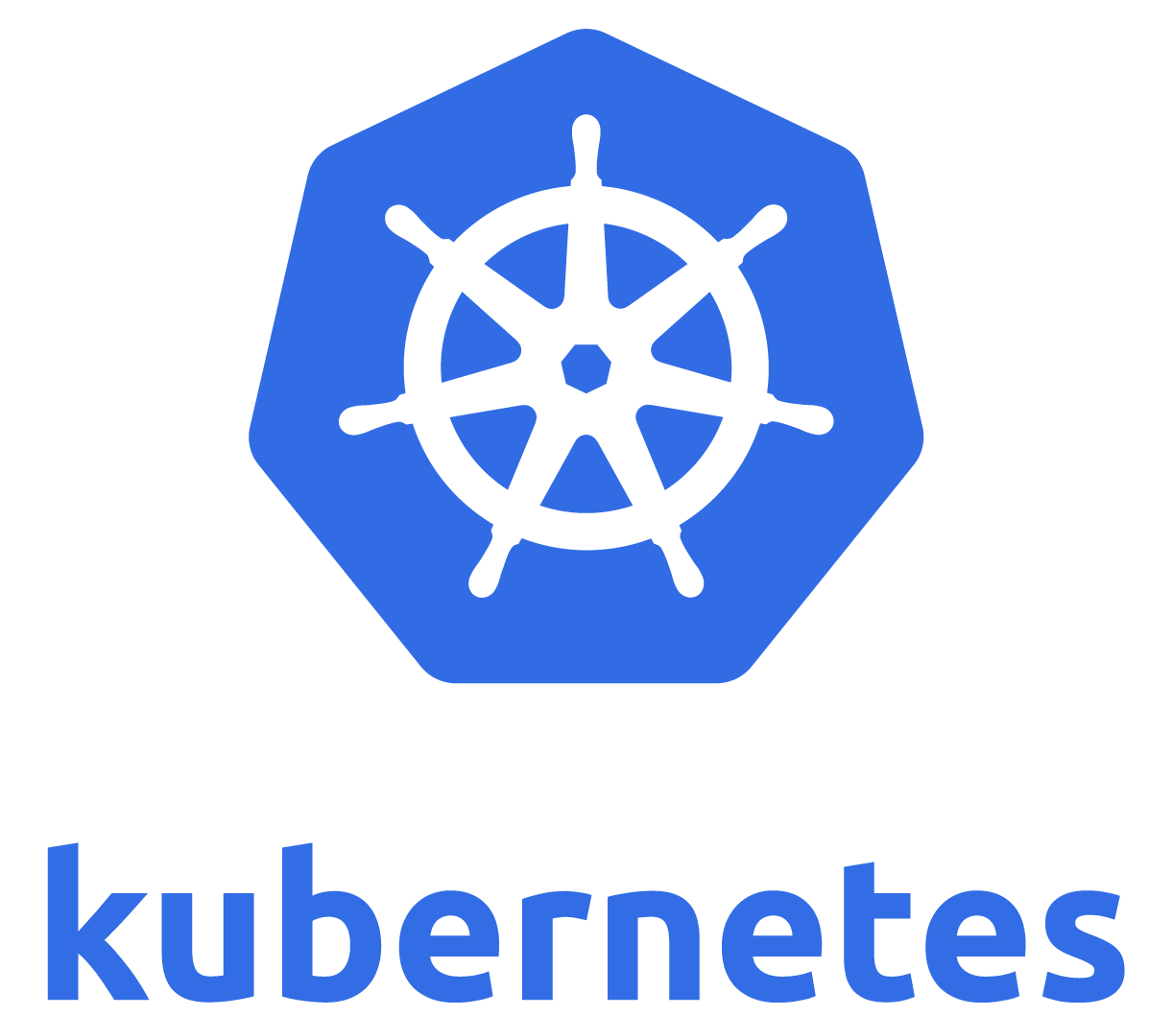
Notes:
So let’s talk a little bit more about Kubernetes

Slide 36

Kubernetes
Kubernetes
Created by Google
Datacenter in a box
Desired State Configuration
Notes:
Instead of running scripts to determine what your data center looks like, you tell it what you want and it gives it to you.
Internal database – etcd – stores cluster state
File Source:
https://github.com/Microsoft/ApplicationInsights-Kubernetes/wiki/Getting-Started-for-.NET-Core-Applications
https://kubernetes.io/docs/concepts/workloads/pods/pod-overview/
https://kubernetes.io/docs/concepts/workloads/controllers/deployment/
https://kubernetes.io/docs/concepts/services-networking/service/

Slide 37
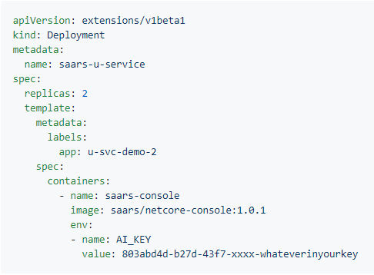

Slide 38
Kubernetes Objects
Pods
Deployments
Services
Volumes
Namespaces
Notes:
Pods - smallest deployable unit | Generally one container (and maybe a sidecar to go with it)
Deployments - groups of Pods | manages things like scalability
Services - Networking between groups of Pods
Volumes – storage
Namespaces – like a resource group, a way to segregate resources
Lots of other objects – load balancers, autoscalers, etc…

Slide 39
What can you run on Kubernetes?
Applications
API Gateways
Databases
Logging and Monitoring Frameworks
etc...
Notes:
There’s probably a docker container for everything you want to do
The only caviat is you don’t want to store state in Kubernetes
----
Docker / Containers are really good for experimentation. You can easily fire up stuff and play with it without having to install a bunch of junk on your machine.

Slide 40
Cloud Native Interactive Landscape
https://landscape.cncf.io/
Notes:
Kubernetes is at the center of a whole cloud native ecosystem.
It has all sorts of stuff...

Slide 41
Demo
Notes:
Show the infrastructure generation scripts to build an Azure Environment

Slide 42
Advocating Cloud Native
Breaking through barriers in your own company.
Notes:
While the tech is great, there’s organizational barriers to overcome.

Slide 43
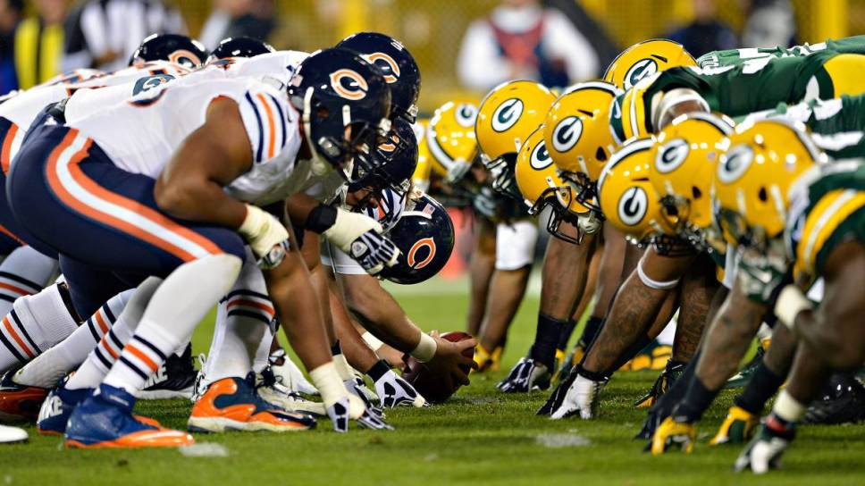
Notes:
Barrier One: Adversarial Team Practices
Measurements that pit one team against another
Classic example:
Dev vs. Ops
Dev – get changes to production
Ops – keep the environment stable by slowing down change
If you want consistent software delivery, you gotta get everyone on the same page.
Photo by football wife from Pexels

Slide 44
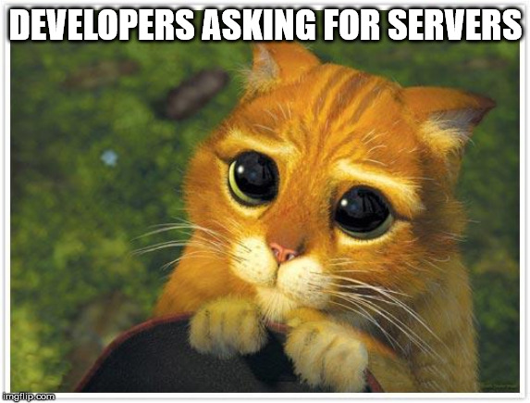
Notes:
When you begin your cloud journey, the desire for ops to lock everything down creates the same kind of structures that the cloud is meant to break down.

Slide 45

Notes:
Cloud Cargo culting – where you build the same non-sensical bureaucracy that the cloud is meant to eliminate.

Slide 46

“Full stack” just got a lot harder
Network Design
Security
Application Orchestration
Database
Back end Code
Front End Code
CDNs and Storage
Notes:
https://www.pexels.com/photo/black-and-white-books-education-facts-433333/
Now that infrastructure is code, developers have to be a lot smarter.

Slide 47
What’s the solution?

Slide 48

Notes:
https://www.pexels.com/photo/group-of-person-sitting-indoors-3184306/
You need to get everyone talking to each other and helping each other out
Break down the silos

Slide 49

Notes:
Though in a bigger corporation it feels more like this

Slide 50
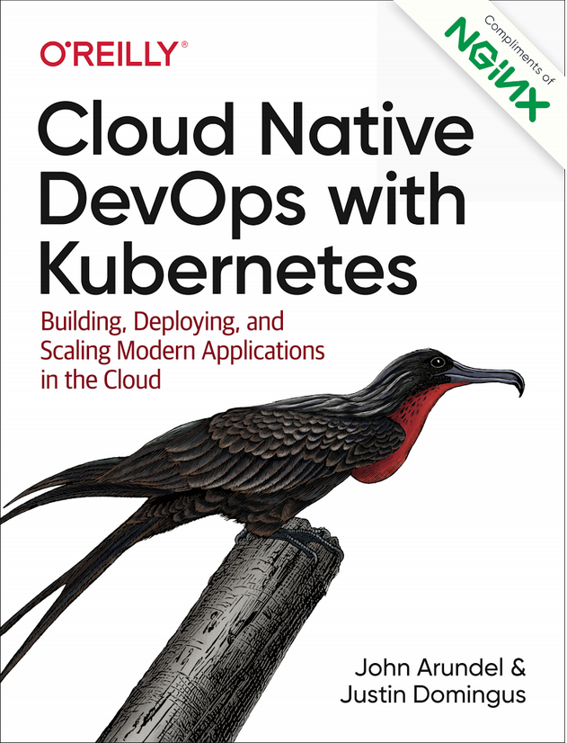
Where to Find More
Cloud Native DevOps with Kubernetes
Microsoft Docs
https://docs.microsoft.com/en-us/azure/aks/
https://docs.microsoft.com/en-us/azure/container-registry/
Microsoft Architecture Guide
https://docs.microsoft.com/en-us/azure/architecture/guide/

Slide 51
Thanks!
Building Cloud Native Apps in ASP.NET
Dustin Ewers | Consultant @ Centare
www.dustinewers.com
https://www.linkedin.com/in/dustinewers/
https://github.com/DustinEwers/cloud-native-dot-net

